Slide 1

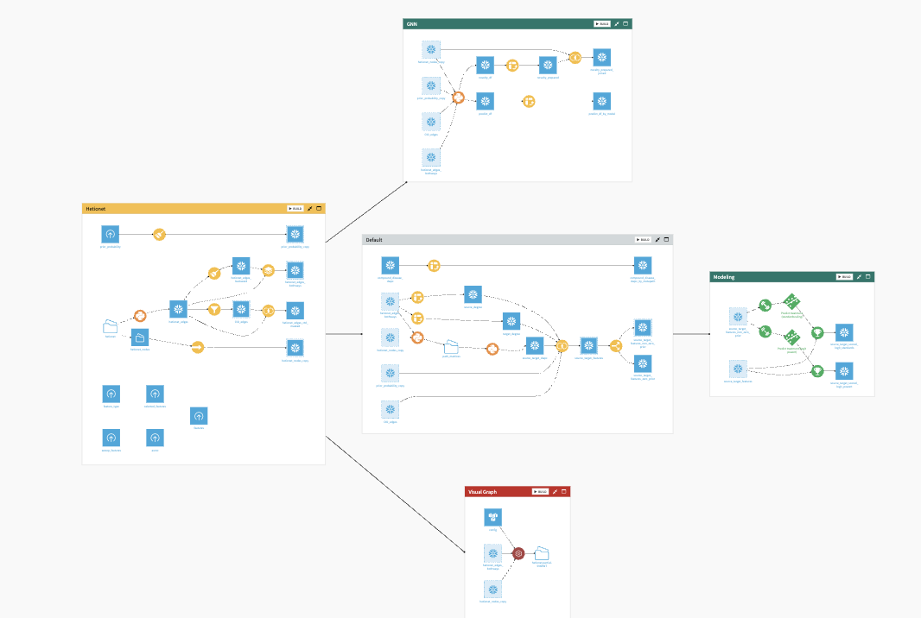
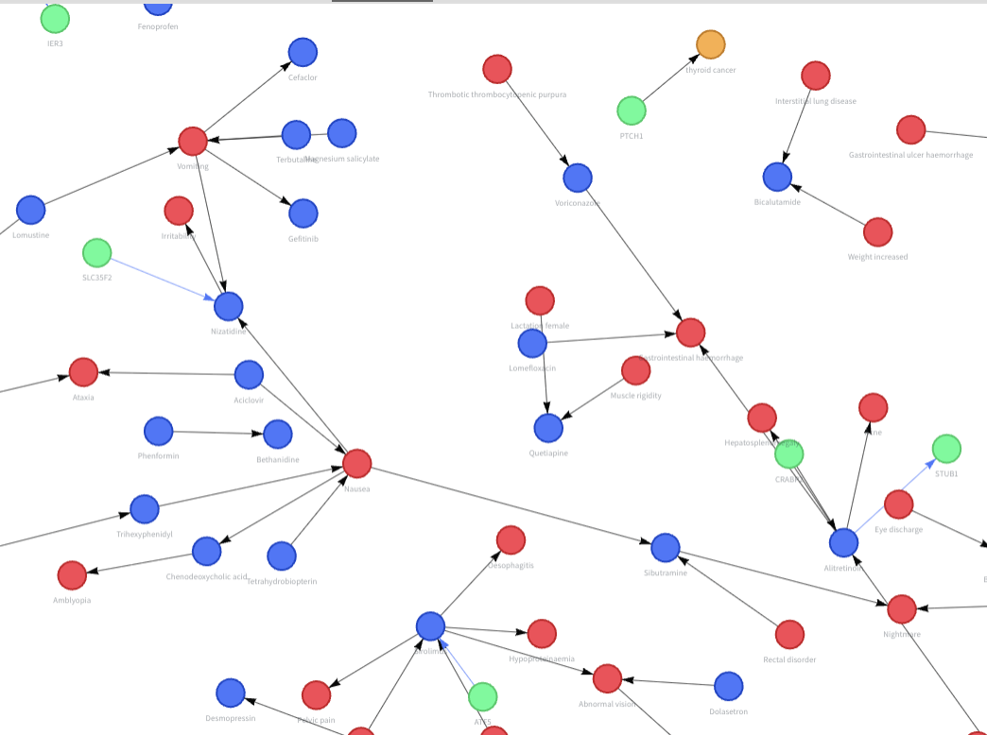



Life Sciences | Drug Discovery R&D
Golden Demo | Knowledge Graph (Part 1)
Business Challenge
Business Value
Business Outcome
Target decisions depend on fragmented biomedical evidence. Teams need a governed way to connect sources, preserve lineage, and make the evidence usable before R&D investment is committed.
Unifies fragmented public and proprietary evidence
Creates an auditable, reusable graph asset
Gives teams a shared view of disease biology and supporting evidence
Industry: Life sciences
Business Function: R&D decision support
Value: Faster, more traceable target-evidence review
Connect and govern biomedical evidence
Governed Dataiku Flow
Explore evidence in context
Public biomedical sources
Proprietary knowledge
Notes:
[Sources]
- docs/overview/PROJECT_CONTEXT.md §1, §4.1
- docs/graph/GRAPH_BUILDING.md §7
Business framing: the graph is a governed, queryable evidence foundation—not an end in itself.

Slide 2
Life Sciences | Drug Discovery R&D
Part 2 | Prioritizer
Business Challenge
Business Value
Business Outcome
A ranked gene list is not enough to drive a portfolio decision. R&D teams need a shortlist they can interrogate, filter, and defend—with clear evidence behind each candidate.
Ranks candidate targets for each disease
Explains why a candidate surfaced and how it connects to disease biology
Lets scientists filter the list on their own decision criteria
Validated champion: 0.823 macro AUC
Coverage: 670 diseases
Value: A transparent shortlist for R&D review
Start with a shared evidence base
Explainable Ranking Flow
Evidence paths for review
Graph-derived features
Business and scientist filters
Notes:
[Sources]
- docs/overview/PROJECT_CONTEXT.md §4.2
- docs/demo/DEMO_NARRATIVE.md, one-page version and Q1–Q5
- .index/models.tsv (champion m7-f14)
The 0.823 figure is macro per-disease AUC; it is not a pooled metric. The slide intentionally does not claim a safety capability.

